Slide 1

Unit - II
Mining Frequent Patterns, Associations, Correlations
Dr. G.Manikandan
ACP / School of Computing
SASTRA Deemed To Be University

Slide 2
Mining Frequent Patterns, Associations, and Correlations
  Basic concepts
    Market Basket Analysis: A Motivating Example
    Frequent Itemsets, Closed Itemsets, and Association Rules

Slide 3
Example - Scenario
Imagine that you are a sales manager at AllElectronics, and you are talking to a customer who recently bought a PC and a digital camera from the store.
What should you recommend to her next?
Information about which products are frequently purchased by your customers following their purchases of a PC and a digital camera in sequence would be very helpful in making your recommendation.
Frequent patterns and association rules are the knowledge that you want to mine in such a scenario.

Slide 4

Association Rule Mining
Medicine
Retail
UX Design
Entertainment
What are association rules?
Association rules are "if-then" statements, that help to show the probability of relationships between data items, within large data sets.
Association rule mining has a number of applications and is widely used to help discover correlations in transactional data or in medical data sets.
An association rule has two parts: an antecedent (if) and a consequent (then).
An antecedent is an item found within the data.
A consequent is an item found in combination with the antecedent.
https://www.techtarget.com/searchbusinessanalytics/definition/association-rules-in-data-mining

Slide 5
Mining Frequent Patterns, Associations, and Correlations
Frequent patterns are patterns that appear frequently in a data set.
  Itemsets - a set of items, such as milk and bread, that appear frequently together in a transaction data set is a frequent itemset.
  Subsequences - such as buying first a PC, then a digital camera, and then a memory card, if it occurs frequently in a shopping history database, is a (frequent) sequential pattern.
  Substructures - can refer to different structural forms, such as subgraphs, or subtrees which may be combined with itemsets or subsequences. If a substructure occurs frequently, it is called a (frequent) structured pattern.
Frequent pattern mining searches for recurring relationships in a given data set.
Finding frequent patterns plays an essential role in mining associations, correlations, and many other interesting relationships among data.

Slide 6
Market Basket Analysis:
A Motivating Example
Suppose, as manager of an AllElectronics branch, you would like to learn more about the buying habits of your customers.
Specifically, you wonder, “Which sets of items are customers likely to purchase on a given trip to the store?”
Each item has a Boolean variable representing the presence or absence of that item.
Each basket can then be represented by a Boolean vector of values assigned to these variables.
The Boolean vectors can be analyzed for buying patterns that reflect items that are frequently associated or purchased together. These patterns can be represented in the form of association rules.
Ex: customers who purchase computers also tend to buy antivirus software at the same time is represented in the following association rule:
computer ⇒ antivirus software [support = 2%, confidence = 60%]

Slide 7
Market Basket Analysis:
A Motivating Example
Rule support and confidence are two measures of rule interestingness.
support (2%) - 2% of all the transactions under analysis show that computer and antivirus software are purchased together.
confidence (60%) - 60% of the customers who purchased a computer also bought the software.
Typically, association rules are considered interesting if they satisfy both a minimum support threshold and a minimum confidence threshold.
These thresholds can be a set by users or domain experts.
Rules that satisfy both min_sup and min_conf are called strong rules

Slide 8
How to calculate support and confidence in data mining?

Slide 9
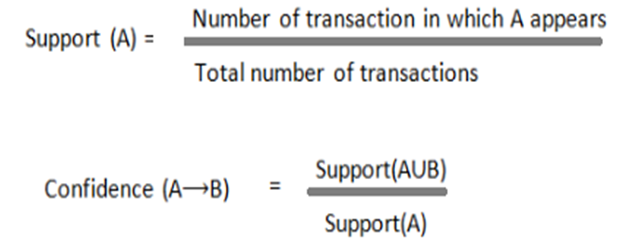
Support and Confidence
where A is the itemset for which you are calculating the support.
Confidence(A => B) = (Number of transactions containing A and B) / (Number of transactions containing A)
https://t4tutorials.com/support-confidence-minimum-support-frequent-itemset-in-data-mining/

Slide 10
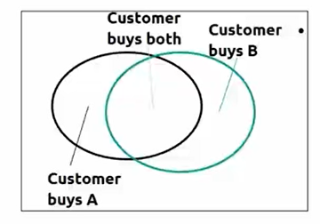
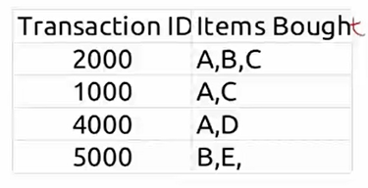
Support and Confidence
Support = 2 / 4 = 50%
Confidence = 2 / 3 = 66.66%
Confidence(X => Y) = (Number of transactions containing X and Y) / (Number of transactions containing X)

Slide 11
Example
Find support and confidence for the rule
Cerelac →Diaper
Diaper →Cerelac
  Cerelac →Diaper (60%, 100%)
  Diaper →Cerelac(60%, 75%)
Tid | Items bought
10 | cerelac, Nuts, Diaper
20 | cerelac, Coffee, Diaper
30 | cerelac, Diaper, Eggs
40 | Nuts, Eggs, Milk
50 | Nuts, Coffee, Diaper, Eggs, Milk
Customer
buys both
Customer
buys diaper
Customer
buys cerelac

Slide 12
Frequent Itemsets, Closed Itemsets, and Association Rules
Let I = {I1, I2,..., Im} be an itemset.
Let D, the task-relevant data, be a set of database transactions where each transaction T is a nonempty itemset such that T ⊆ I.
Let A be a set of items. A transaction T is said to contain A if A ⊆ T.
An association rule is an implication of the form A ⇒ B, where A ⊂ I, B ⊂ I, A ≠ ∅ and
B ≠ ∅
The rule A ⇒ B - support s, where s is the percentage of transactions in D that contain A ∪ B . This is taken to be the probability, P(A ∪ B)
The rule A ⇒ B - confidence c in the transaction set D, where c is the percentage of transactions in D containing A that also contain B. This is taken to be the conditional probability, P(B|A).
support(A⇒B)=P(A∪B) confidence (A⇒B) =P(B|A)

Slide 13
Frequent Itemsets, Closed Itemsets, and Association Rules
A set of items is referred to as an itemset.
An itemset that contains k items is a k-itemset.
Ex: The set {computer, antivirus software} is a 2-itemset.
The occurrence frequency of an itemset is the number of transactions that contain the itemset. (frequency, support count, or count of the itemset).

Slide 14
Support
(absolute) support of X :
  The number of transactions which
  contains an item. X.
Absolute Support of {cerelac} is 3
(relative) support of X :
  is the fraction of transactions that contains X relative to the total transactions.
  Relative Support of {cerelac} is 3/5
If the relative support of an itemset I satisfies a prespecified minimum support threshold, then I is a frequent itemset.
Tid | Items bought
10 | cerelac, Nuts, Diaper
20 | cerelac, Coffee, Diaper
30 | cerelac, Diaper, Eggs
40 | Nuts, Eggs, Milk
50 | Nuts, Coffee, Diaper, Eggs, Milk

Slide 15
Frequent Itemsets, Closed Itemsets, and Association Rules
In general, association rule mining can be viewed as a two-step process:
  Find all frequent itemsets:
    By definition, each of these itemsets will occur at least as frequently as a predetermined minimum support count, min sup.
  Generate strong association rules from the frequent itemsets:
    By definition, these rules must satisfy minimum support and minimum confidence.

Slide 16
Closed Patterns and Max-Patterns
A major challenge in mining frequent itemsets from a large data set is the fact that such mining often generates a huge number of itemsets satisfying the minimum support (min sup) threshold, especially when min sup is set low.
This is because if an itemset is frequent, each of its subsets is frequent as well.
A long itemset will contain a combinatorial number of shorter, frequent sub-itemsets.

Slide 17
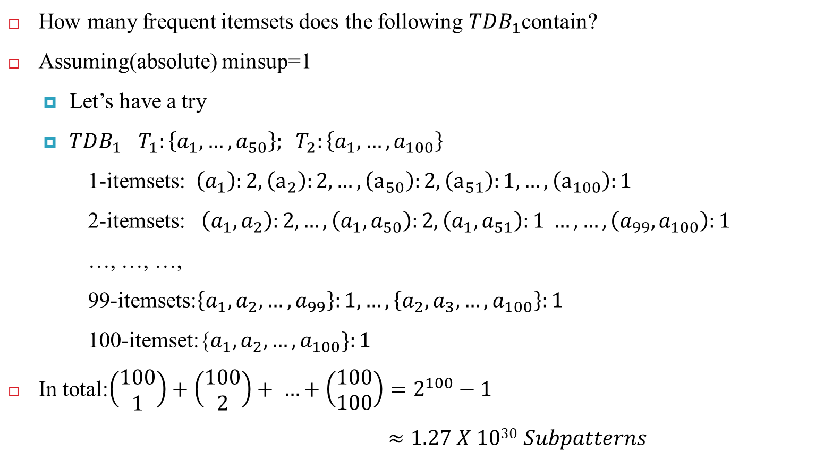
Closed Patterns and Max-Patterns
How many frequent itemsets does the following $TDB_{1}$contain?
Assuming(absolute) minsup=1
  Let’s have a try
  $TDB_{1}$ $T_{1}:\left\{a_{1},…, a_{50}\right\}; T_{2}:\left\{a_{1}, …,a_{100}\right\}$
1-itemsets: $\left(a_{1}\right):2, \left(a_{2}\right):2, …,\left(a_{50}\right):2,\left(a_{51}\right):1, …,\left(a_{100}\right):1$
2-itemsets: $\left(a_{1},a_{2}\right):2, …,\left(a_{1},a_{50}\right):2,\left(a_{1},a_{51}\right):1 …,…,\left(a_{99},a_{100}\right):1$
…, …, …,
99-itemsets:$\left\{a_{1},a_{2}, …,a_{99}\right\}:1,…, \left\{a_{2}, a_{3}, …,a_{100}\right\}:1$
100-itemset:{$a_{1}, a_{2}, …,a_{100}\}:1$
In total:$\left(\begin{aligned}100 \\ 1\end{aligned}\right)+\left(\begin{aligned}100 \\ 2\end{aligned}\right)+ …+\left(\begin{aligned}100 \\ 100\end{aligned}\right)=2^{100}−1$
$≈1.27 X 1030$ $Subpatterns$
Solution: Mine closed patterns
A too huge set for
Any computer to compute or store!

Slide 18
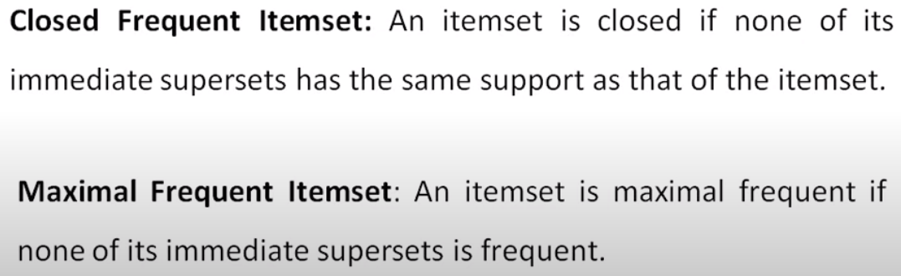
Closed Patterns and Max-Patterns

Slide 19
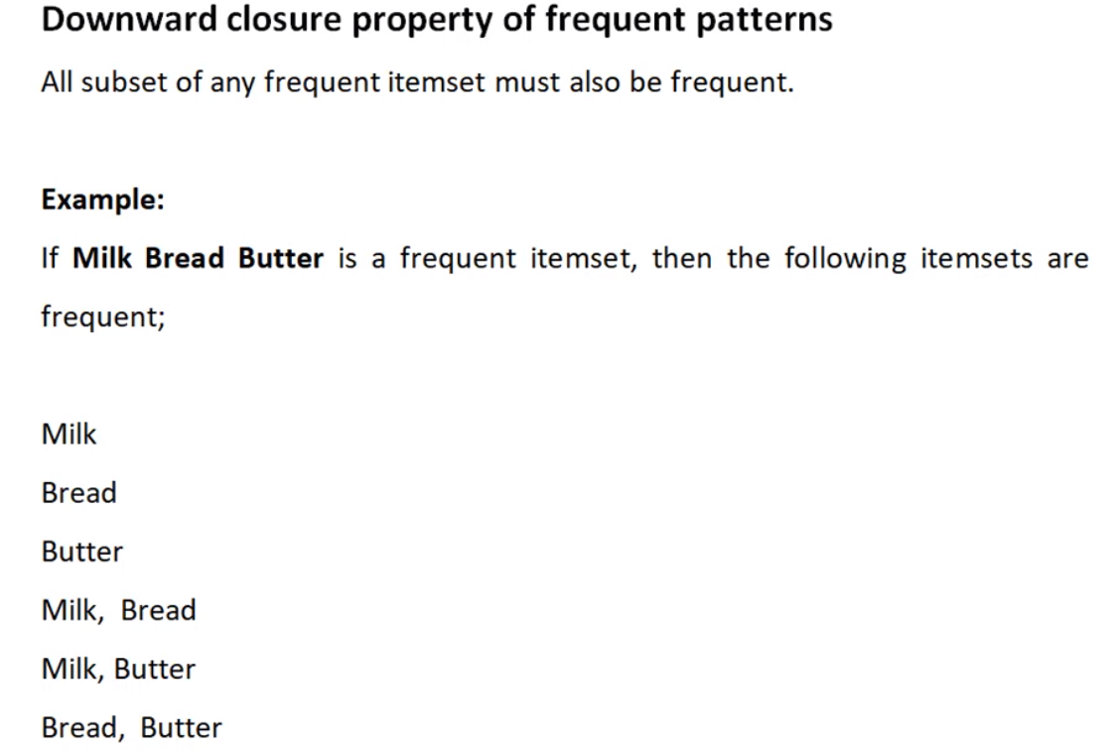
Closed Patterns and Max-Patterns

Slide 20
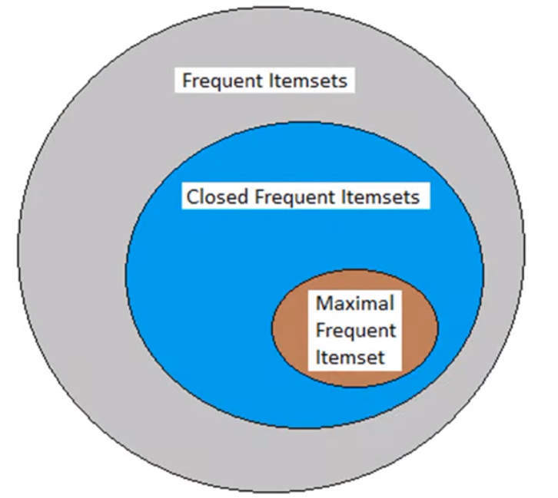
Closed Patterns and Max-Patterns

Slide 21
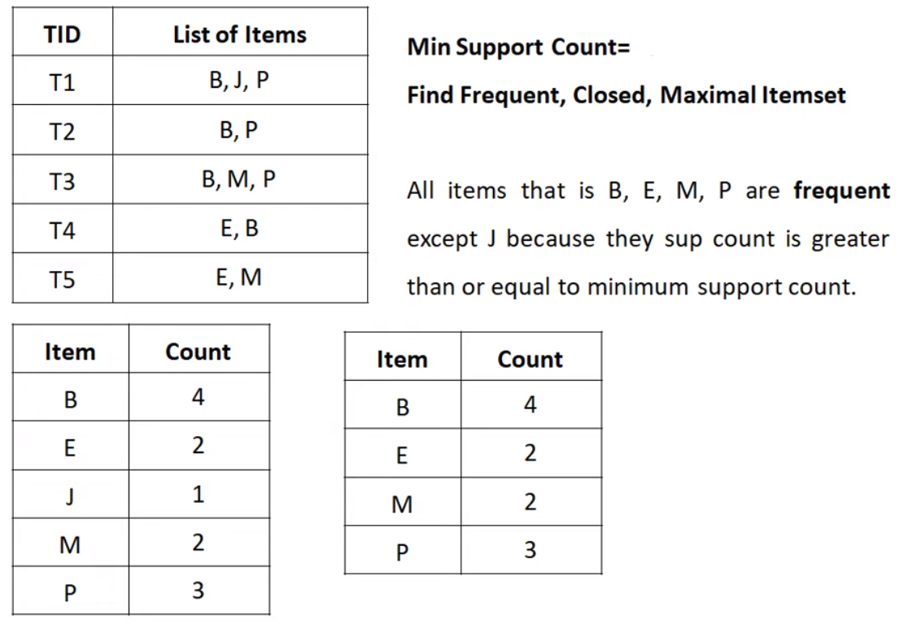
Closed Patterns and Max-Patterns - Example
2

Slide 22
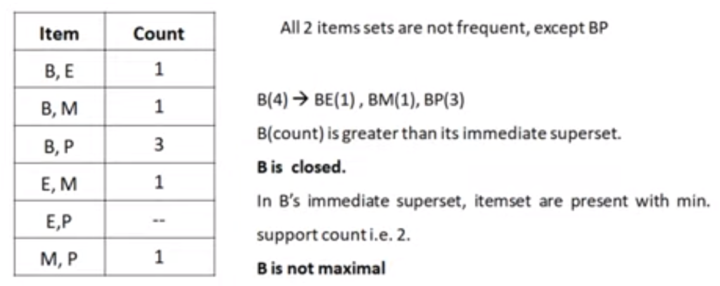
Closed Patterns and Max-Patterns - Example

Slide 23
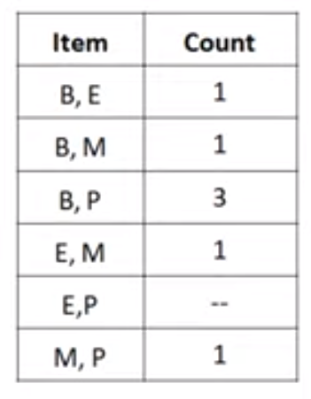
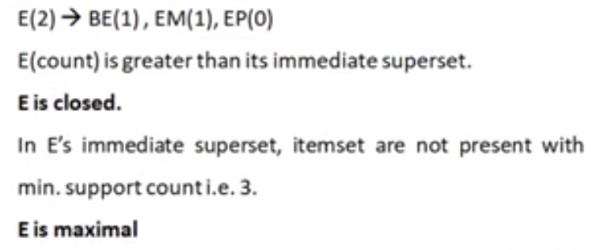
Closed Patterns and Max-Patterns - Example
2

Slide 24
References
https://www.youtube.com/watch?v=HuXyvETwoUo
https://www.youtube.com/watch?v=OEupexDlgv0

Slide 25



